Slide 1
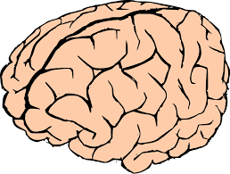
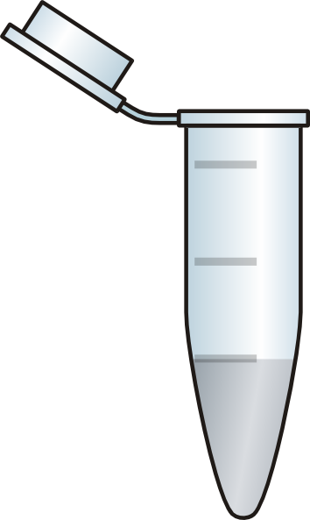
Homogenize
1000g
10min
S1
200 mg angular gyrus
3000g
10min
P1
S2
5400g
15min
P2
S3
12,200g
15min
Nuclei
S4
P3
Mitochondria
24,000g
15min
S5
P4
Mitochondria
78,400g
15min
P5
S6
P6
Smaller membranous organelles
Cytosol
Large protein complexes

